Slide 1
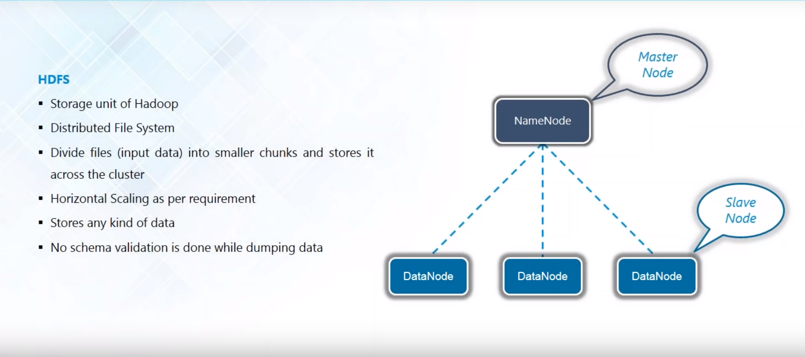
HDFS

Slide 2
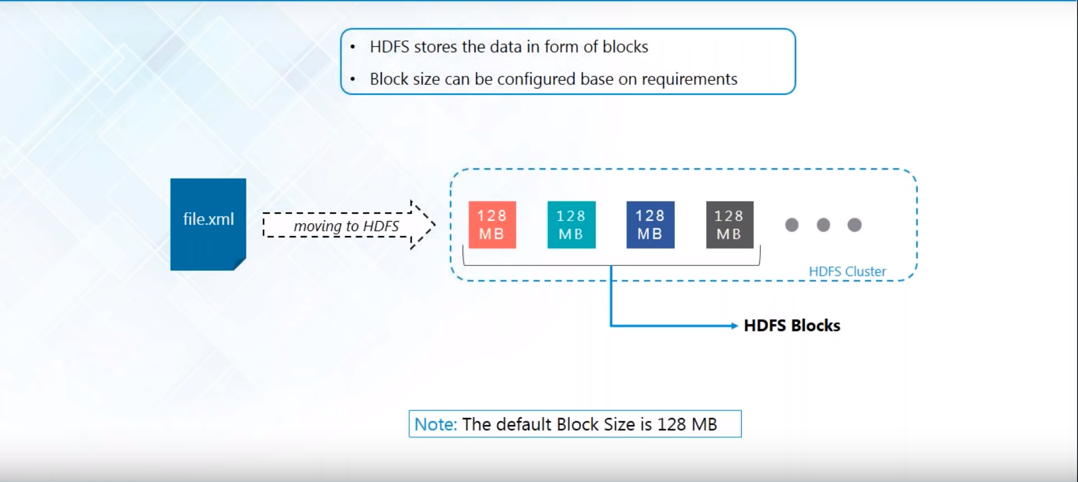
HDFS BLock

Slide 3
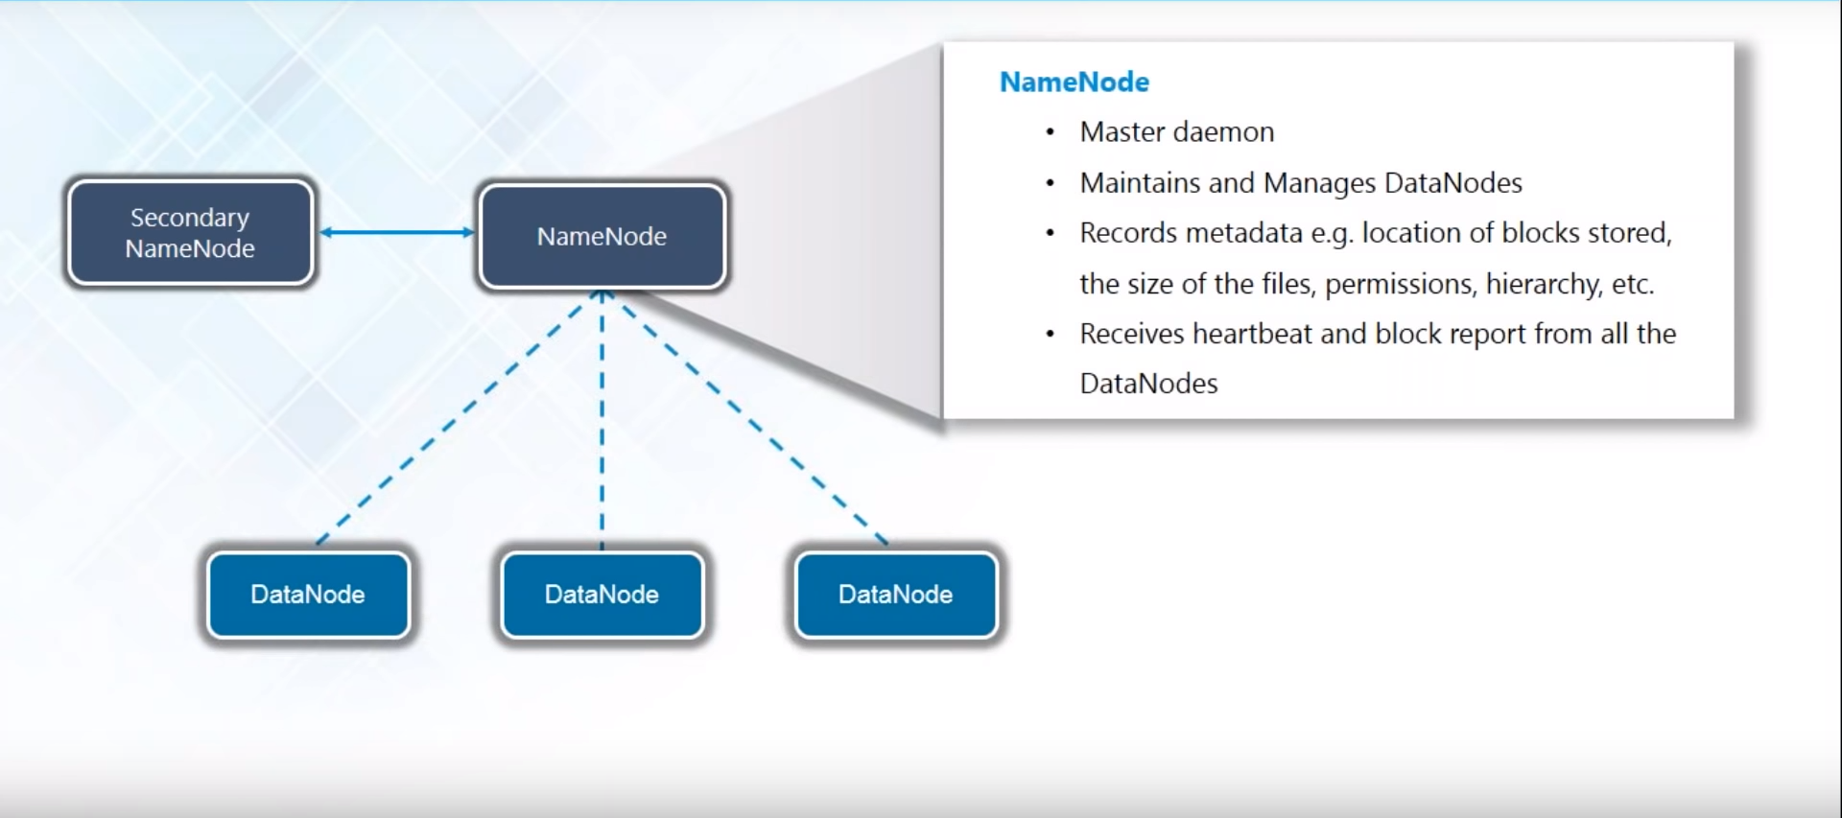
nAMENODe

Slide 4
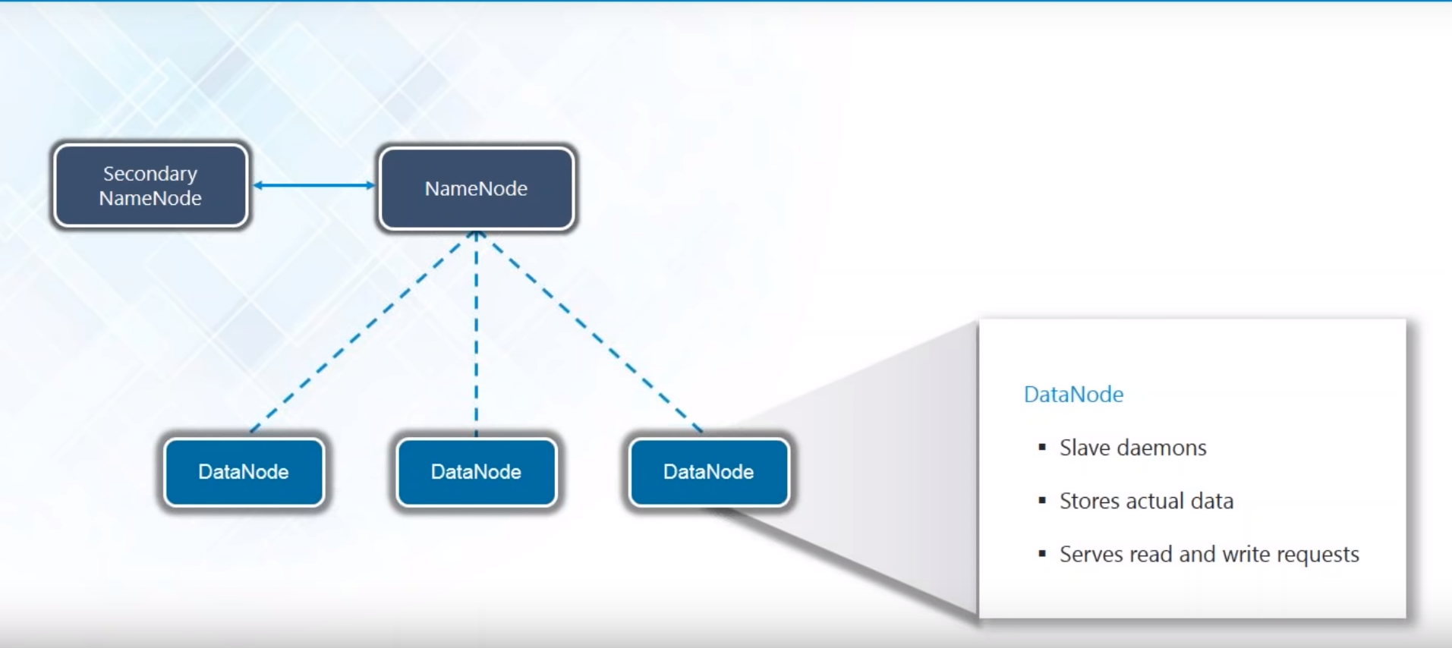
datanode

Slide 5
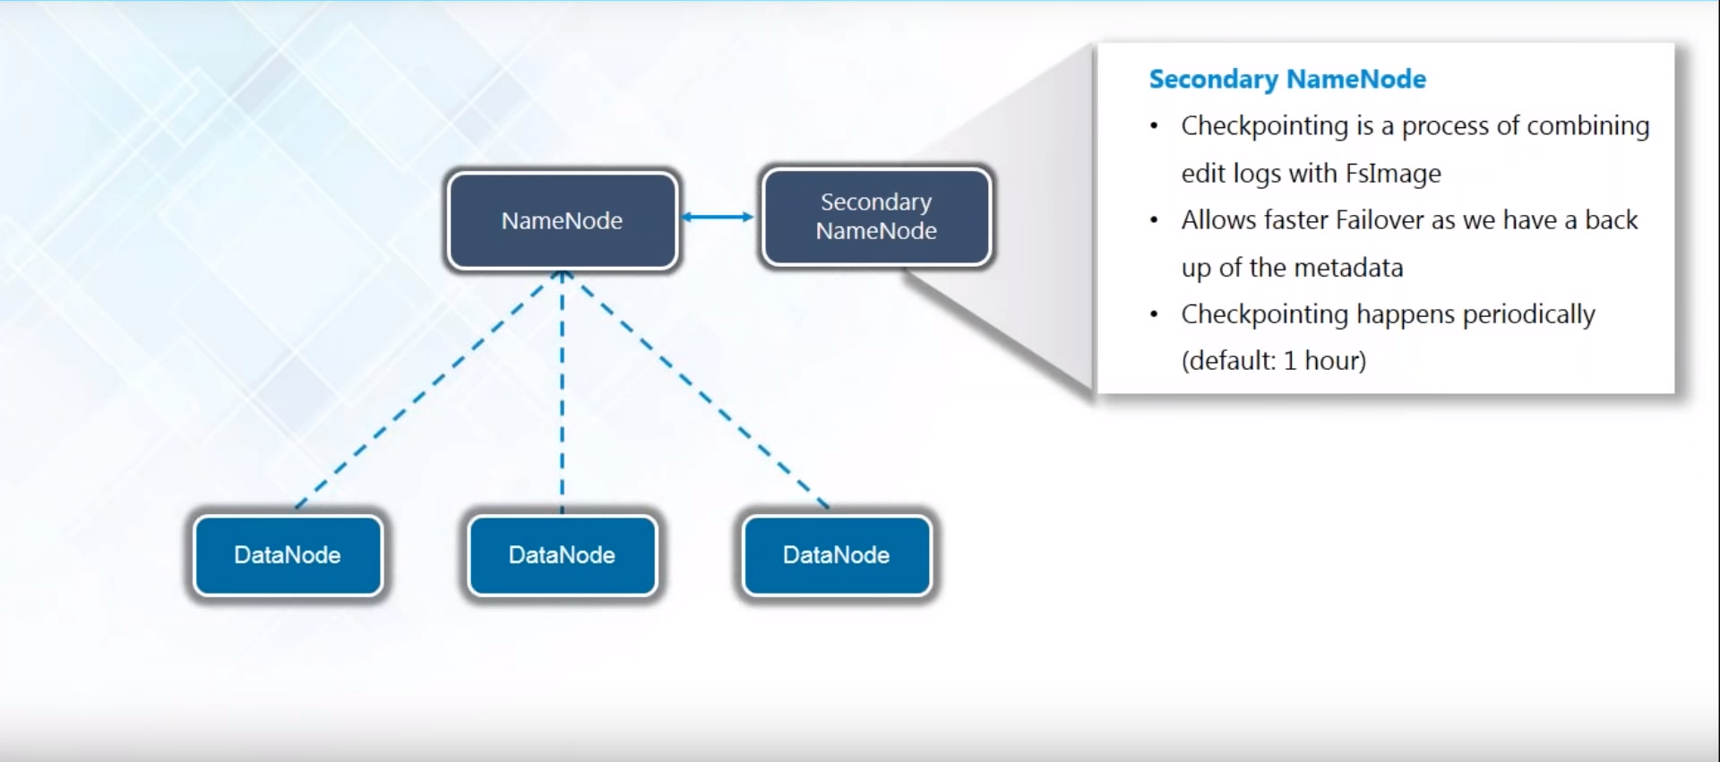
Secondary namenode

Slide 6
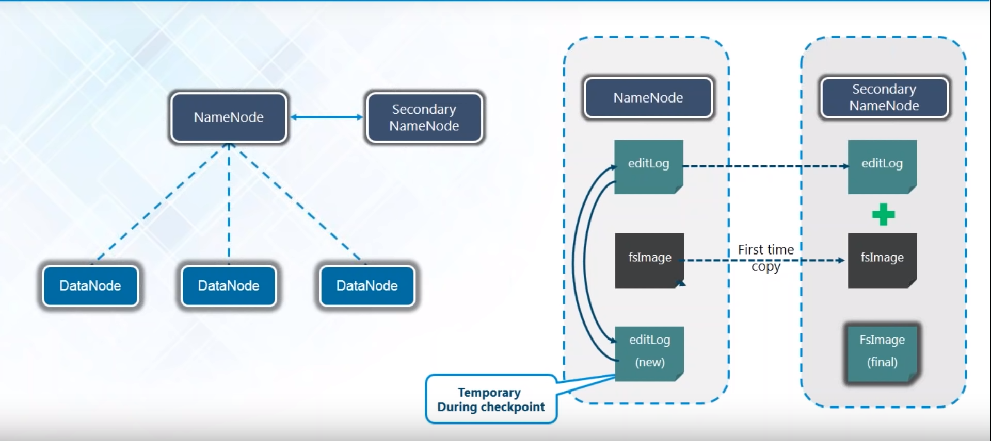
Hadoop distributed file system

Slide 7
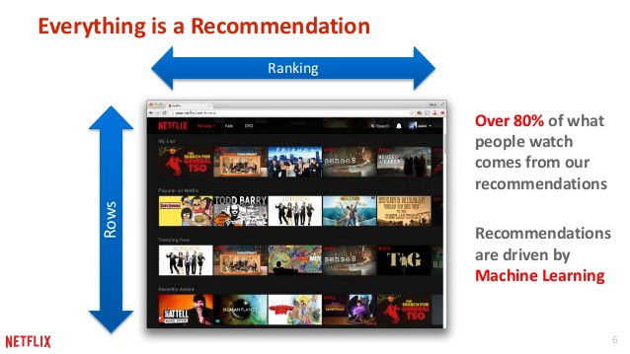
Real Life Cases
Netflix : knows which movies you will like before you know it.
Indian Telecom Company used payment history to estimate credit score to see who was worthy of loans.

Slide 8
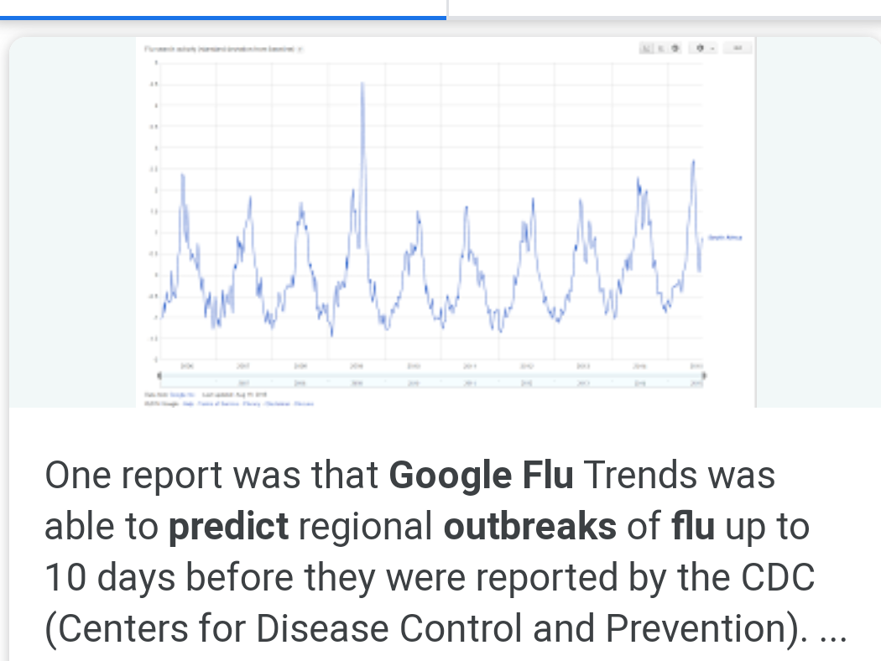
Flu Outbreak: Google knows couple of weeks before about a flu outbreak before CDC(Centre for disease control)
Facebook returning 1000 page document to a guy who requested his data.

Slide 9
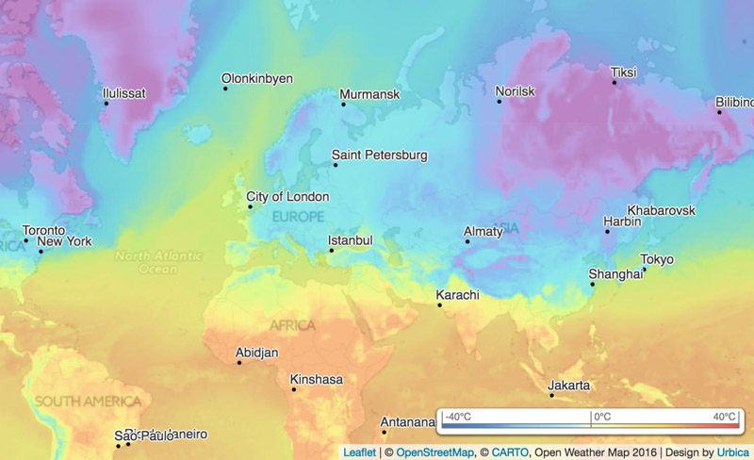
Weather forecasting : Satellites check for high pressure and low pressure zones

Slide 10
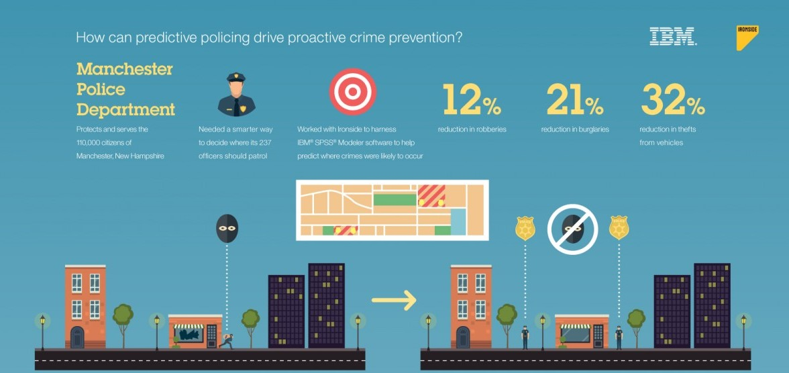
Predictive Policing: preventing crimes by predicting them.

